Slide 1

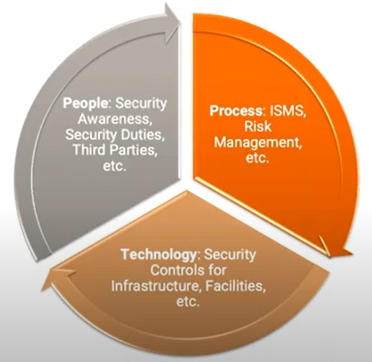
CS 3002 Information Security
Fall 2024
Week # 11 – Lecture #30, 31 and 32
29, 30 and 31st October 2024
Dr. Aqsa Aslam

Slide 2
Basic principle
Quick Detection and Response: Rapid detection of intrusions can help identify and remove intruders before any significant damage occurs.
Even if immediate prevention isn’t possible, early detection minimizes damage and accelerates recovery efforts.
Deterrence: A well-functioning IDS can deter potential intruders from attempting attacks due to the risk of detection.
Information Gathering: Intrusion detection systems collect data on intrusion techniques, which can inform and enhance preventive measures.

Slide 3

Although the typical behavior of an intruder differs from the typical behavior of an authorized user, there is an overlap in these behaviors.
Thus, a loose of intruder behavior, which will catch more intruders, will also lead to a number of false positives, or false alarms, where authorized users are identified as intruders.
On the other hand, an attempt to limit false positives by a tight interpretation of intruder behavior will lead to an increase in false negatives, or intruders not identified as intruders. Thus, there is an element of compromise and art in the practice of intrusion detection.
Probability density function
.
profile of authorized user
behavior
profile of intruder behavior
overlap in observed or expected behavior
average behavior of intruder
average behavior of authorized user
Measurable behavior parameter
Figure 8.1 Profiles of Behavior of Intruders and Authorized Users
Notes:
Authentication facilities, access control facilities, and firewalls all play a role in
countering intrusions. Another line of defense is intrusion detection, and this has
been the focus of much research in recent years. This interest is motivated by a
number of considerations, including the following:
1. If an intrusion is detected quickly enough, the intruder can be identified and
ejected from the system before any damage is done or any data are compromised.
Even if the detection is not sufficiently timely to preempt the intruder,
the sooner that the intrusion is detected, the less the amount of damage and
the more quickly that recovery can be achieved.
2. An effective IDS can serve as a deterrent, thus acting to prevent intrusions.
3. Intrusion detection enables the collection of information about intrusion techniques
that can be used to strengthen intrusion prevention measures.
Intrusion detection is based on the assumption that the behavior of the intruder
differs from that of a legitimate user in ways that can be quantified. Of course, we
cannot expect that there will be a crisp, exact distinction between an attack by an
intruder and the normal use of resources by an authorized user. Rather, we must
expect that there will be some overlap.
Figure 8.1 suggests, in abstract terms, the nature of the task confronting the
designer of an IDS. Although the typical behavior of an intruder differs from the
typical behavior of an authorized user, there is an overlap in these behaviors. Thus,
a loose interpretation of intruder behavior, which will catch more intruders, will
also lead to a number of false positives , or false alarms, where authorized users are
identified as intruders. On the other hand, an attempt to limit false positives by a
tight interpretation of intruder behavior will lead to an increase in false negatives ,
or intruders not identified as intruders. Thus, there is an element of compromise
and art in the practice of intrusion detection. Ideally you want an IDS to have a high
detection rate, that is, the ratio of detected to total attacks, while minimizing the
false alarm rate, the ratio of incorrectly classified to total normal usage [LAZA05].
In an important early study of intrusion [ANDE80], Anderson postulated
that one could, with reasonable confidence, distinguish between an outside attacker
and a legitimate user. Patterns of legitimate user behavior can be established by
observing past history, and significant deviation from such patterns can be detected.
Anderson suggests that the task of detecting an inside attacker (a legitimate user
acting in an unauthorized fashion) is more difficult, in that the distinction between
abnormal and normal behavior may be small. Anderson concluded that such violations
would be undetectable solely through the search for anomalous behavior.
However, insider behavior might nevertheless be detectable by intelligent definition
of the class of conditions that suggest unauthorized use. These observations,
which were made in 1980, remain true today.

Slide 4
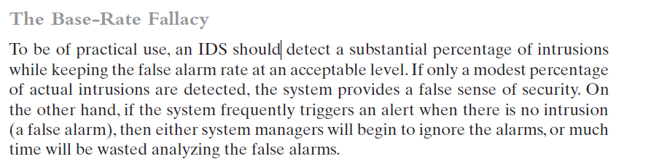
.
In general, if the actual numbers of intrusions is low compared to the number of legitimate uses of a system, then the false alarm rate will be high unless the test is extremely discriminating. This is an example of a phenomenon known as the baserate fallacy.
For example, If among 10 malicious events, 9 will detected as a malicious, which mean we have 1 false negative.
A false positive (FP) state is when the IDS identifies an activity as an attack but the activity is acceptable behavior. A false positive is a false alarm.
A false negative (FN) state is the most serious and dangerous state. This is when the IDS identifies an activity as acceptable when the activity is actually an attack. That is, a false negative is when the IDS fails to catch an attack.
FP
FN
Notes:
Authentication facilities, access control facilities, and firewalls all play a role in
countering intrusions. Another line of defense is intrusion detection, and this has
been the focus of much research in recent years. This interest is motivated by a
number of considerations, including the following:
1. If an intrusion is detected quickly enough, the intruder can be identified and
ejected from the system before any damage is done or any data are compromised.
Even if the detection is not sufficiently timely to preempt the intruder,
the sooner that the intrusion is detected, the less the amount of damage and
the more quickly that recovery can be achieved.
2. An effective IDS can serve as a deterrent, thus acting to prevent intrusions.
3. Intrusion detection enables the collection of information about intrusion techniques
that can be used to strengthen intrusion prevention measures.
Intrusion detection is based on the assumption that the behavior of the intruder
differs from that of a legitimate user in ways that can be quantified. Of course, we
cannot expect that there will be a crisp, exact distinction between an attack by an
intruder and the normal use of resources by an authorized user. Rather, we must
expect that there will be some overlap.
Figure 8.1 suggests, in abstract terms, the nature of the task confronting the
designer of an IDS. Although the typical behavior of an intruder differs from the
typical behavior of an authorized user, there is an overlap in these behaviors. Thus,
a loose interpretation of intruder behavior, which will catch more intruders, will
also lead to a number of false positives , or false alarms, where authorized users are
identified as intruders. On the other hand, an attempt to limit false positives by a
tight interpretation of intruder behavior will lead to an increase in false negatives ,
or intruders not identified as intruders. Thus, there is an element of compromise
and art in the practice of intrusion detection. Ideally you want an IDS to have a high
detection rate, that is, the ratio of detected to total attacks, while minimizing the
false alarm rate, the ratio of incorrectly classified to total normal usage [LAZA05].
In an important early study of intrusion [ANDE80], Anderson postulated
that one could, with reasonable confidence, distinguish between an outside attacker
and a legitimate user. Patterns of legitimate user behavior can be established by
observing past history, and significant deviation from such patterns can be detected.
Anderson suggests that the task of detecting an inside attacker (a legitimate user
acting in an unauthorized fashion) is more difficult, in that the distinction between
abnormal and normal behavior may be small. Anderson concluded that such violations
would be undetectable solely through the search for anomalous behavior.
However, insider behavior might nevertheless be detectable by intelligent definition
of the class of conditions that suggest unauthorized use. These observations,
which were made in 1980, remain true today.

Slide 5
IDS Requirements
Run continually
Be fault tolerant
Resist subversion
Run continually
Be fault tolerant
Resist subversion
Impose a minimal overhead on system
Configured according to system security policies
Adapt to changes in systems and users
Impose a minimal overhead on system
Configured according to system security policies
Adapt to changes in systems and users
Scale to monitor large numbers of systems
Provide graceful degradation of service
Allow dynamic reconfiguration
Scale to monitor large numbers of systems
Provide graceful degradation of service
Allow dynamic reconfiguration

Slide 6
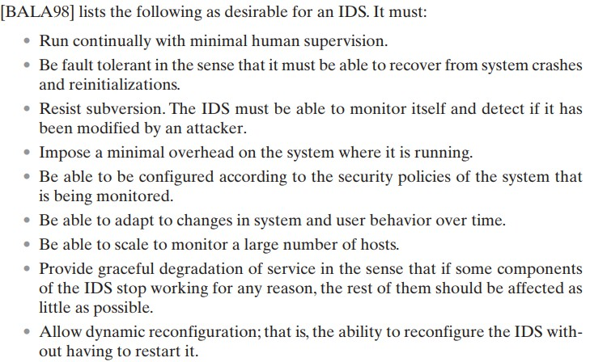

Slide 7
Analysis Approaches
Signature/Heuristic detection
Anomaly detection
Involves the collection of data relating to the behavior of legitimate users over a period of time
Current observed behavior is analyzed to determine whether this behavior is that of a legitimate user or that of an intruder
Uses a set of known malicious data patterns or attack rules that are compared with current behavior
Also known as misuse
detection
Can only identify known attacks for which it has patterns or rules

Slide 8

Anomaly Detection
A variety of classification approaches are used:
Statistical
Knowledge based
Machine-learning
Analysis of the observed behavior using univariate, multivariate, or time-series models of observed metrics
Approaches use an expert system that classifies observed behavior according to a set of rules that model legitimate behavior
Approaches automatically determine a suitable classification model from the training data using data mining techniques

Slide 9



Signature or Heuristic Detection
Rule-based heuristic identification
Signature approaches
Match a large collection of known patterns of malicious data against data stored on a system or in transit over a network
Involves the use of rules for identifying known penetrations or penetrations that would exploit known weaknesses
The signatures need to be large enough to minimize the false alarm rate, while still detecting a sufficiently large fraction of malicious data
Rules can also be defined that identify suspicious behavior, even when the behavior is within the bounds of established patterns of usage
Widely used in anti-virus products, network traffic scanning proxies, and in NIDS
Typically rules used are specific
SNORT is an example of a rule-based NIDS

Slide 10
Host-Based Intrusion Detection (HIDS)
Adds a specialized layer of security software to vulnerable or sensitive systems
Can use either anomaly or signature and heuristic approaches
Monitors activity to detect suspicious behavior
Primary purpose is to detect intrusions, log suspicious events, and send alerts
Can detect both external and internal intrusions

Slide 11

Data Sources and Sensors
Common data sources include:
System call traces
Audit (log file) records
File integrity checksums
Registry access
A fundamental component of intrusion detection is the sensor that collects data
The sensor gathers data from the chosen source, filters the gathered data to remove any unwanted information and to standardize the information format, and forwards the result to the IDS analyzer, which may be local or remote.

Slide 12
Figure 8.2 shows the overall architecture of DID, which consists of three main components:
1. Host agent module: An audit collection module operating as a background process on a monitored system. Its purpose is to collect data on security-related events on the host and transmit these to the central manager.
2. LAN monitor agent module: Operates in the same fashion as a host agent module except that it analyzes LAN traffic and reports the results to the central manager.
3. Central manager module: Receives reports from LAN monitor and host agents and processes and correlates these reports to detect intrusion.
Notes:
Traditionally, work on host-based IDSs focused on single-system stand-alone operation.
The typical organization, however, needs to defend a distributed collection
of hosts supported by a LAN or internetwork. Although it is possible to mount a
defense by using stand-alone IDSs on each host, a more effective defense can be
achieved by coordination and cooperation among IDSs across the network.
Porras points out the following major issues in the design of a distributed IDS
[PORR92]:
• A distributed IDS may need to deal with different sensor data formats. In a
heterogeneous environment, different systems may use different sensors and
approaches to gathering data for intrusion detection use.
• One or more nodes in the network will serve as collection and analysis points
for the data from the systems on the network. Thus, either raw sensor data or
summary data must be transmitted across the network. Therefore, there is a
requirement to assure the integrity and confidentiality of these data. Integrity
is required to prevent an intruder from masking his or her activities by altering
the transmitted audit information. Confidentiality is required because the
transmitted audit information could be valuable.
• Either a centralized or decentralized architecture can be used. With a centralized
architecture, there is a single central point of collection and analysis of all
sensor data. This eases the task of correlating incoming reports but creates a
potential bottleneck and single point of failure. With a decentralized architecture,
there is more than one analysis center, but these must coordinate their
activities and exchange information.
A good example of a distributed IDS is one developed at the University of
California at Davis [HEBE92, SNAP91]; a similar approach has been taken for a
project at Purdue [SPAF00, BALA98]. Figure 8.2 shows the overall architecture,
which consists of three main components:
1. Host agent module: An audit collection module operating as a background
process on a monitored system. Its purpose is to collect data on security-related
events on the host and transmit these to the central manager. Figure 8.3
shows details of the agent module architecture.
2. LAN monitor agent module: Operates in the same fashion as a host agent
module except that it analyzes LAN traffic and reports the results to the central
manager.
3. Central manager module: Receives reports from LAN monitor and host
agents and processes and correlates these reports to detect intrusion.

Slide 13
Figure 8.3 shows details of the agent module architecture.
Figure 8.3 shows the general approach that is taken.
The agent captures each audit record produced by the native audit collection system.
A filter is applied that retains only those records that are of security interest.
These records are then reformatted into a standardized format referred to as the host audit record (HAR).
Next, a template-driven logic module analyzes the records for suspicious activity.
At the lowest level, the agent scans for notable events that are of interest independent of any past events.
Notes:
The scheme is designed to be independent of any operating system or system
auditing implementation. Figure 8.3 shows the general approach that is taken. The
agent captures each audit record produced by the native audit collection system. A
filter is applied that retains only those records that are of security interest. These
records are then reformatted into a standardized format referred to as the host
audit record (HAR). Next, a template-driven logic module analyzes the records for
suspicious activity. At the lowest level, the agent scans for notable events that are
of interest independent of any past events. Examples include failed files, accessing
system files, and changing a file’s access control. At the next higher level, the agent
looks for sequences of events, such as known attack patterns (signatures). Finally,
the agent looks for anomalous behavior of an individual user based on a historical
profile of that user, such as number of programs executed, number of files accessed,
and the like.
When suspicious activity is detected, an alert is sent to the central manager.
The central manager includes an expert system that can draw inferences from
received data. The manager may also query individual systems for copies of HARs
to correlate with those from other agents.
The LAN monitor agent also supplies information to the central manager.
The LAN monitor agent audits host-host connections, services used, and volume of
traffic. It searches for significant events, such as sudden changes in network load,
the use of security-related services, and suspicious network activities.
The architecture depicted in Figures 8.2 and 8.3 is quite general and flexible.
It offers a foundation for a machine-independent approach that can expand from
stand-alone intrusion detection to a system that is able to correlate activity from
a number of sites and networks to detect suspicious activity that would otherwise
remain undetected.

Slide 14

Network-Based IDS (NIDS)
Monitors traffic at selected
points on a network
May examine network, transport, and/or application-level protocol activity
Examines traffic packet by packet in real or close to real time
May examine network, transport, and/or application-level protocol activity
Monitors traffic at selected
points on a network
Comprised of a number of sensors, one or more servers for NIDS management functions, and one or more management consoles for the human interface
Analysis of traffic patterns may be done at the sensor, the management server or a combination of the two
Comprised of a number of sensors, one or more servers for NIDS management functions, and one or more management consoles for the human interface
Analysis of traffic patterns may be done at the sensor, the management server or a combination of the two
A NIDS examines packet traffic directed toward potentially vulnerable computer systems on a network.
A host-based system examines user and software activity on a host.

Slide 15
Types of Network Sensors
Sensors can be deployed in one of two modes:
Inline
Passive
Inline sensor:
Inserted directly into a network segment; monitored traffic must pass through it.
Can be combined with existing network devices (e.g., firewall, LAN switch) using only NIDS software, eliminating extra hardware.
Can also be deployed as a standalone inline NIDS sensor.
Enables active blocking of detected attacks, providing both intrusion detection and intrusion prevention functions.
Suitable for environments where immediate attack prevention is necessary.

Slide 16
Types of Network Sensors
Passive Sensor
Monitors a copy of network traffic without interrupting the actual traffic flow.
More commonly used due to higher efficiency and minimal impact on traffic flow.
Does not introduce additional handling or delay, making it optimal for monitoring-only roles.
Focused on detection and alerting without actively preventing attacks.
Ideal for environments prioritizing non-intrusive network analysis and monitoring.

Slide 17


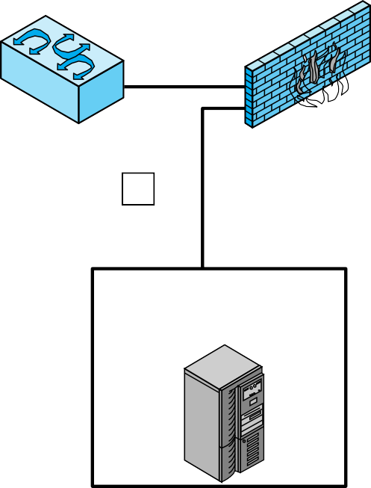



Internet
internal server and data resource networks
3
LAN switch or router
internal firewall
2
LAN switch or router
external firewall
1
workstation networks
service network (Web, Mail, DNS, etc.)
4
LAN switch or router
internal firewall
Figure 8.5
Example of NIDS Sensor Deployment

Slide 18
NIDS Sensor Deployment
A common location for a NIDS sensor is just inside the external firewall (location 1 in the figure).
This position has a number of advantages:
Sees attacks, originating from the outside world, that penetrate the network’s perimeter defenses (external firewall).
Highlights problems with the network firewall policy or performance.
Sees attacks that might target the Web server or ftp server.
Even if the incoming attack is not recognized, the IDS can sometimes recognize the outgoing traffic that results from the compromised server.
Figure 8.5 illustrates a number of possibilities
Notes:
Consider an organization with multiple sites, each of which has one or more LANs,
with all of the networks interconnected via the Internet or some other WAN
technology. For a comprehensive NIDS strategy, one or more sensors are needed
at each site. Within a single site, a key decision for the security administrator is the
placement of the sensors.
Figure 8.5 illustrates a number of possibilities. In general terms, this configuration
is typical of larger organizations. All Internet traffic passes through an external firewall
that protects the entire facility. Traffic from the outside world, such as customers and
vendors that need access to public services, such as Web and mail, is monitored. The
external firewall also provides a degree of protection for those parts of the network
that should only be accessible by users from other corporate sites. Internal firewalls
may also be used to provide more specific protection to certain parts of the network.
A common location for a NIDS sensor is just inside the external firewall
( location 1 in the figure). This position has a number of advantages:
• Sees attacks, originating from the outside world, that penetrate the network’s
perimeter defenses (external firewall).
• Highlights problems with the network firewall policy or performance.
• Sees attacks that might target the Web server or ftp server.
• Even if the incoming attack is not recognized, the IDS can sometimes recognize
the outgoing traffic that results from the compromised server.
Instead of placing a NIDS sensor inside the external firewall, the security
administrator may choose to place a NIDS sensor between the external firewall and
the Internet or WAN (location 2 ). In this position, the sensor can monitor all network
traffic, unfiltered. The advantages of this approach are as follows:
• Documents number of attacks originating on the Internet that target the network
• Documents types of attacks originating on the Internet that target the network
A sensor at location 2 has a higher processing burden than any sensor located
elsewhere on the site network.
In addition to a sensor at the boundary of the network, on either side of the
external firewall, the administrator may configure a firewall and one or more sensors
to protect major backbone networks, such as those that support internal servers
and database resources (location 3). The benefits of this placement include the
following:
• Monitors a large amount of a network’s traffic, thus increasing the possibility
of spotting attacks
• Detects unauthorized activity by authorized users within the organization’s
security perimeter
Thus, a sensor at location 3 is able to monitor for both internal and external
attacks. Because the sensor monitors traffic to only a subset of devices at the site, it can
be tuned to specific protocols and attack types, thus reducing the processing burden.
Finally, the network facilities at a site may include separate LANs that support
user workstations and servers specific to a single department. The administrator
could configure a firewall and NIDS sensor to provide additional protection for
all of these networks or target the protection to critical subsystems, such as personnel
and financial networks (location 4). A sensor used in this latter fashion provides
the following benefits:
• Detects attacks targeting critical systems and resources
• Allows focusing of limited resources to the network assets considered of
greatest value
As with a sensor at location 3, a sensor at location 4 can be tuned to specific
protocols and attack types, thus reducing the processing burden.

Slide 19
Intrusion Detection Techniques
Attacks suitable for Signature detection
Application layer reconnaissance and attacks
Transport layer reconnaissance
and attacks
Network layer reconnaissance and attacks
Unexpected application
services
Policy violations
Attacks suitable for Anomaly detection
Denial-of-service (DoS) attacks
Scanning
Worms

Slide 20
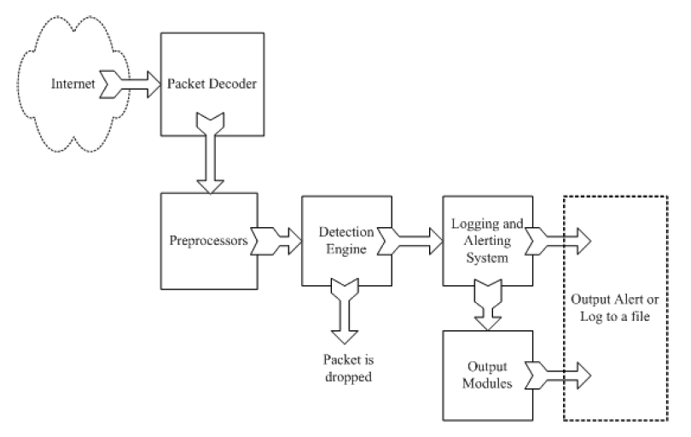
Example: Snort
http://www.snort.org/
From: Rafeeq Ur Rehman, Intrusion Detection Systems with Snort: Advanced IDS Techniques with Snort, Apache, MySQL, PHP, and ACID.

Slide 21
Stateful Protocol Analysis (SPA)
Subset of anomaly detection that compares observed network traffic against predetermined universal vendor supplied profiles of benign protocol traffic
This distinguishes it from anomaly techniques trained with
organization specific traffic protocols
Understands and tracks network, transport, and application protocol states to ensure they progress as expected
A key disadvantage is the high resource use it requires

Slide 22
Logging of Alerts
Typical information logged by a NIDS sensor includes:
Timestamp
Connection or session ID
Event or alert type
Rating
Network, transport, and application layer protocols
Source and destination IP addresses
Source and destination TCP or UDP ports, or ICMP types and codes
Number of bytes transmitted over the connection
Decoded payload data, such as application requests and responses
State-related information

Slide 23
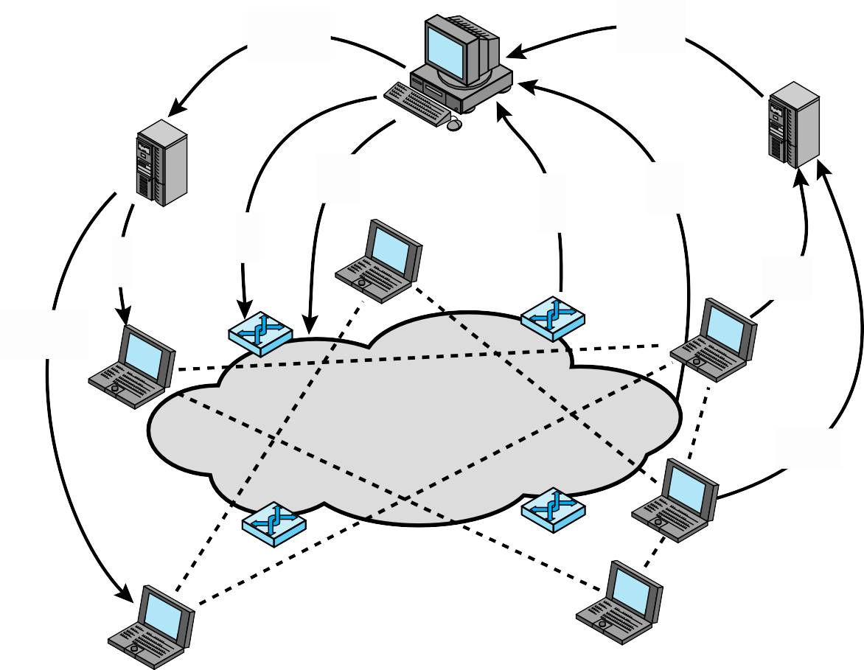
Adaptive feedback based policies
Platform policies
Summary events
Collaborative policies
Network policies
DDI
events
PEP
events
Platform policies
Platform events
Platform policies
Distributed detection and inference
Platform events
gossip
PEP = policy enforcement point
DDI = distributed detection and infer ence
Figure 8.6 Overall Architecture of an Autonomic Enterprise Security System

Slide 24
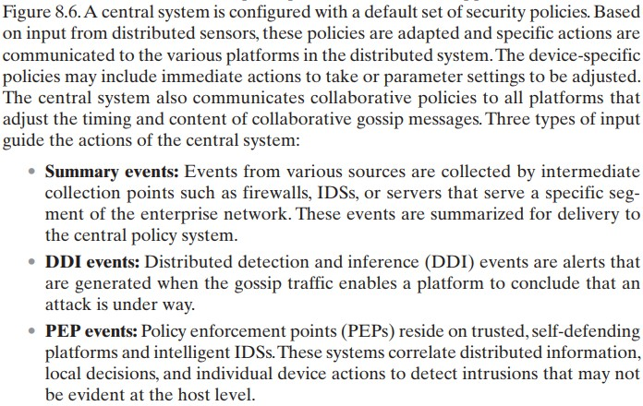

Slide 25
Summary
Host-based intrusion detection
Data sources and sensors
Anomaly HIDS
Signature or heuristic HIDS
Distributed HIDS
Network-based intrusion detection
Types of network sensors
NIDS sensor deployment
Intrusion detection techniques
Logging of alerts
Example system: Snort
Snort architecture
Snort rules
Intruders
Intruder behavior
Intrusion detection
Basic principles
The base-rate fallacy
Requirements
Analysis approaches
Anomaly detection
Signature or heuristic detection
Distributed or hybrid intrusion detection
Intrusion detection exchange
format
Honeypots

